Slide 1


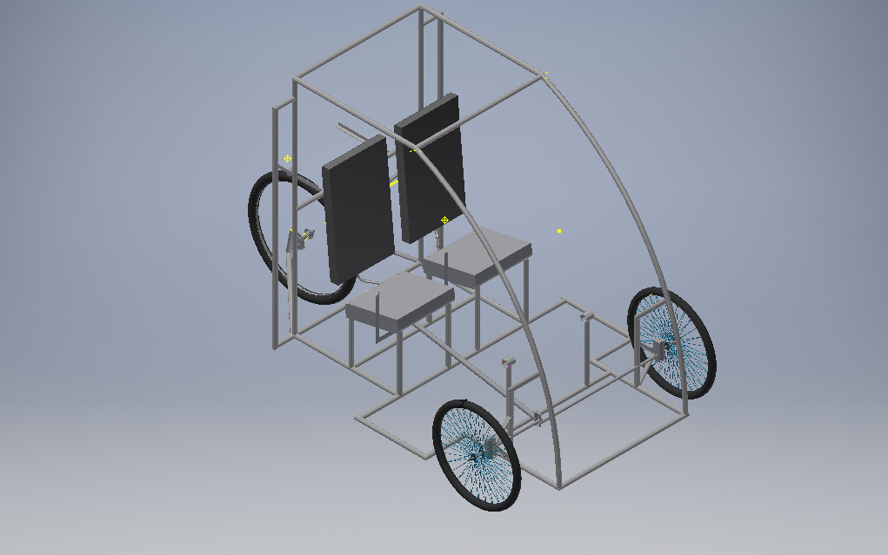

TEAM VEGAM
Dayananda Sagar College Of Engineering
EFFICYCLE
2017

Slide 2


About Efficycle
“EFFI-CYCLE” derived from Efficient-Cycle .
It’s a competition to design and fabricate a three wheel configuration(tadpole) vehicle powered by human-electric hybrid power.
The vehicle must be aerodynamic, engineered for performance, safety and ergonomically designed.
Competition will be conducted by SAE ( Society of Automobile Engineers ) NIS in Lovely Professional University , Punjab, from 1st to 5th November 2017.

Slide 3

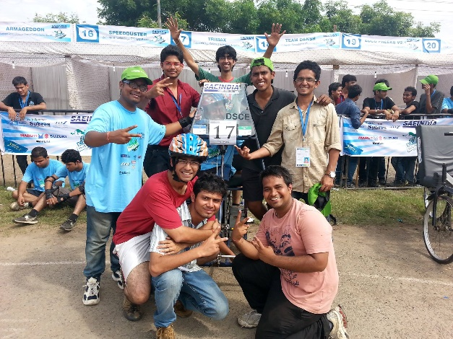
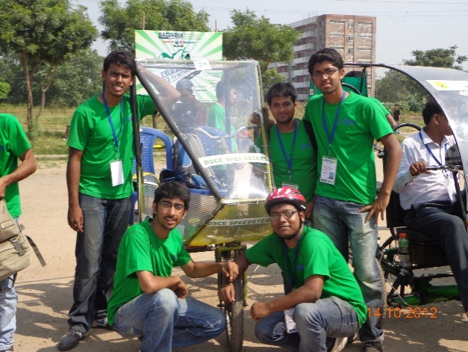
Team VEGAM
We are a SAE EFFICYCLE team of passionate engineering from Dayananda Sagar College of Engineering.
We are team consisting of 9 students from Mechanical , Automobile and Electrical department combined together with various areas of expertise like design, analysis , electrical system,etc .
We are supported by our HOD and guided by Professor Nandakumar Basavaraju .
Previous attempts at SAE EFFICYCLE : 2012, 2013
2013
2012

Slide 4
About us and Specialization
Ashray Pai (Team Captain) | Design , Braking and Wheels
Priyanka Jay (Team Vice Captain ) | Steering
Prathik Kamath | Design and Innovation
Akhilesh Arjun | Human Drive Train
Suraksha Shetty | Human Drive Train
Asif | Electrical Drive train
Vishal | Electrical Drive train
Niraj Botra | Ergonomics and seating
Prajwal Pai | Ergonomics and seating

Slide 5


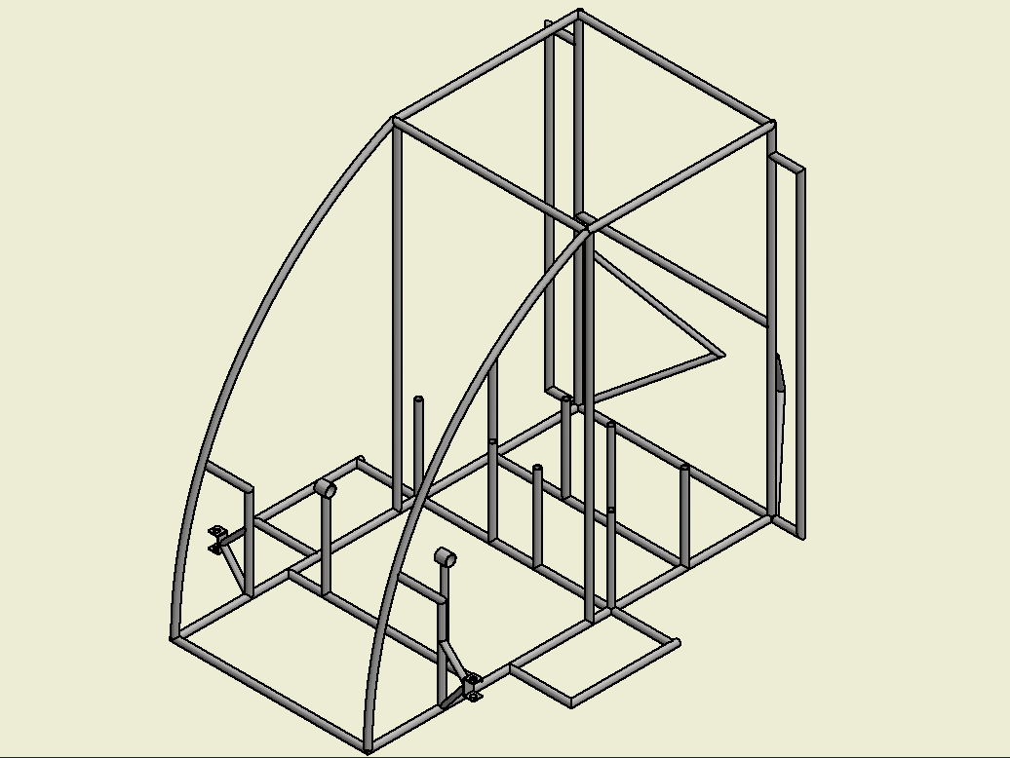
Vehicle Frame Design

Slide 6

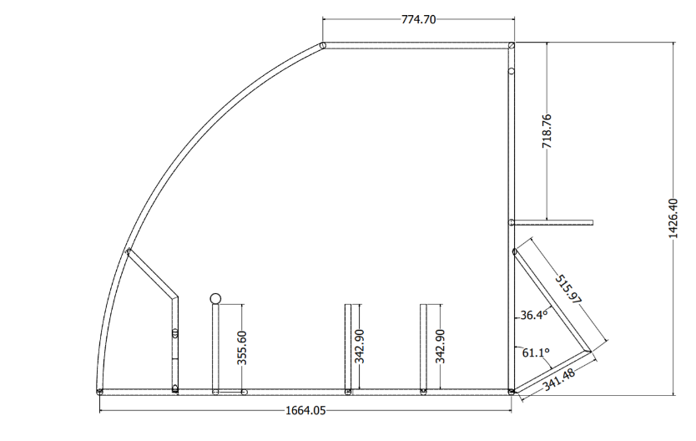
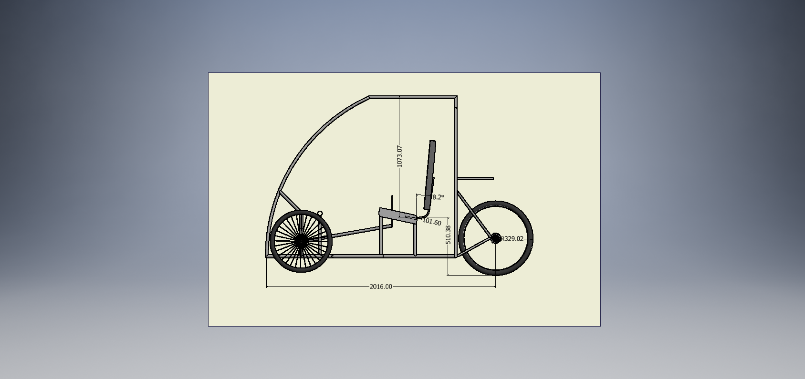
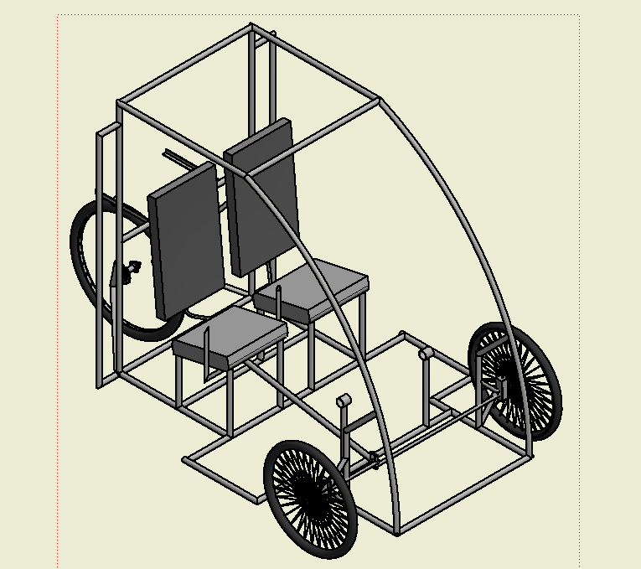
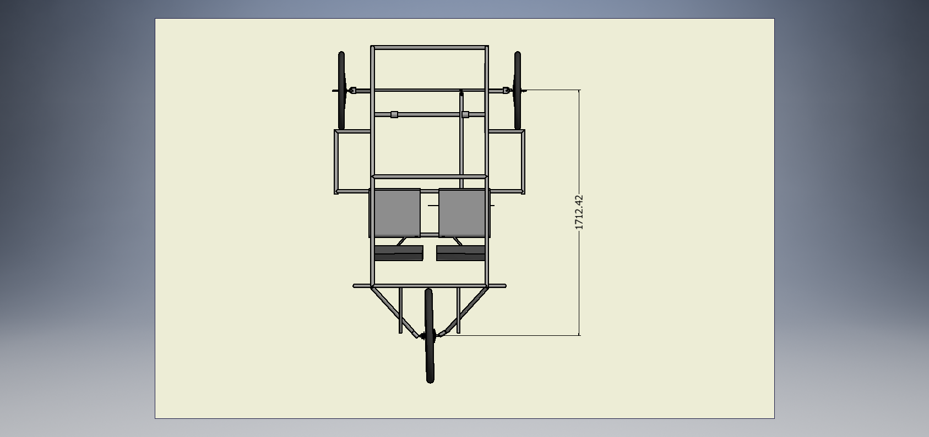
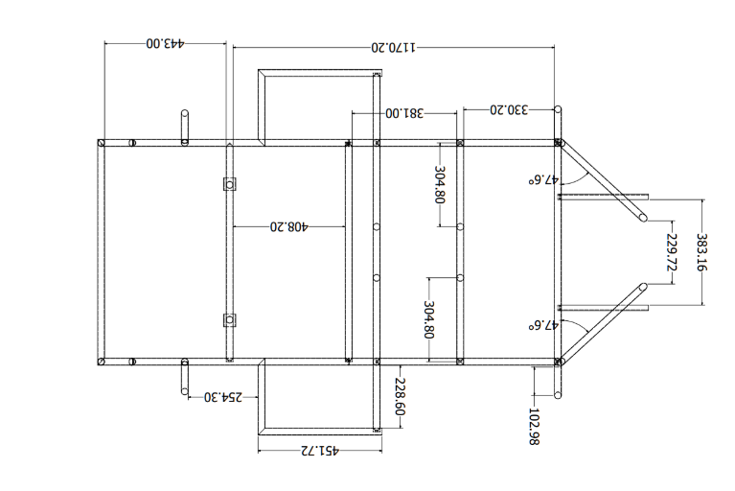
Frame CAD model

Slide 7

CAD / CAE report
Particulars | AISI 1018 | AISI 3074 | AISI 1020
Thickness (mm) | 2 | 2 | 2
Outer diameter (mm) | 25.4 | 25.4 | 25.4
Yield strength (MPa) | 365 | 373 | 350
Ultimate Strength (MPa) | 440 | 409 | 420
Density(g/cc) | 7.87 | 7.87 | 7.87
Modulus of Elasticity (GPa) | 205 | 210 | 205
Carbon content (%) | 0.14% | 0.05% | 0
Weld ability | Good | Good | Good
Corrosion resistance | Good | Excellent | Good
Lead time for delivery (days) | 7 | 5 | 8
Availability | Easily Available | Easily Available | Not Easily Available
Cost Rs/m | 105 | 78 | 92
FRAME MATERIAL OPTIONS
STEELALLOY (AISI 1018 ) CROSS-SECTION TYPE; 25.4 X 21.4 X 2
STEEL ALLOY (AISI 3074) CROSS-SECTION TYPE; 25.4 X 21.4 X 2
STEEL ALLOY (AISI 1020) CROSS-SECTION TYPE; 25.4 X 21.4 X 2
WHERE;
A = OUTER DIA FOR CIRCULAR SECTION, BIGGER SIDE FOR RECTANGULAR SECTION, MAJOR AXIS IN CASE OF ELLIPTICAL SECTION ETC. (ALL DIMENSIONS IN MM OR INCH)
B= INNER DIA FOR CIRCULAR SECTION, SMALLER SIDE FOR RECTANGULAR SECTION, MINOR AXIS IN CASE OF ELLIPTICAL SECTION ETC. (ALL DIMENSIONS IN MM ON INCH)
T= WALL THICKNESS IN MM OR INCH.

Slide 8
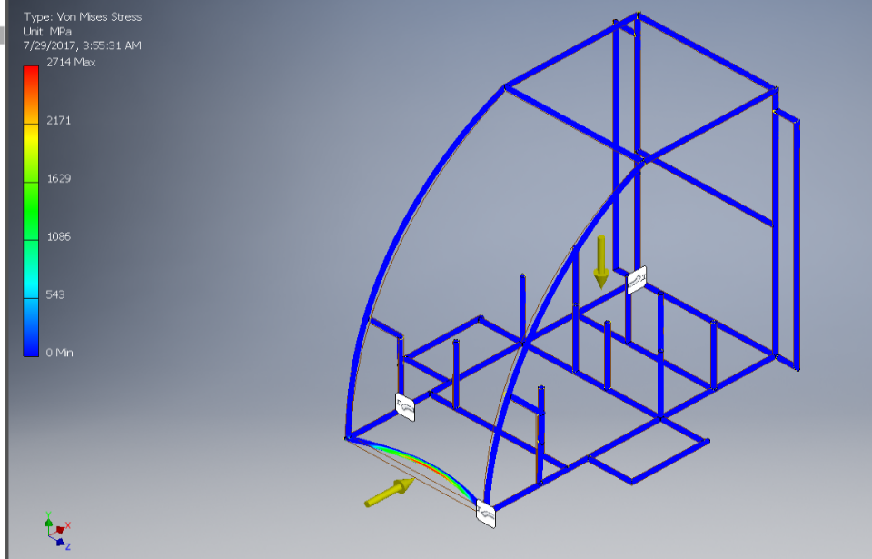
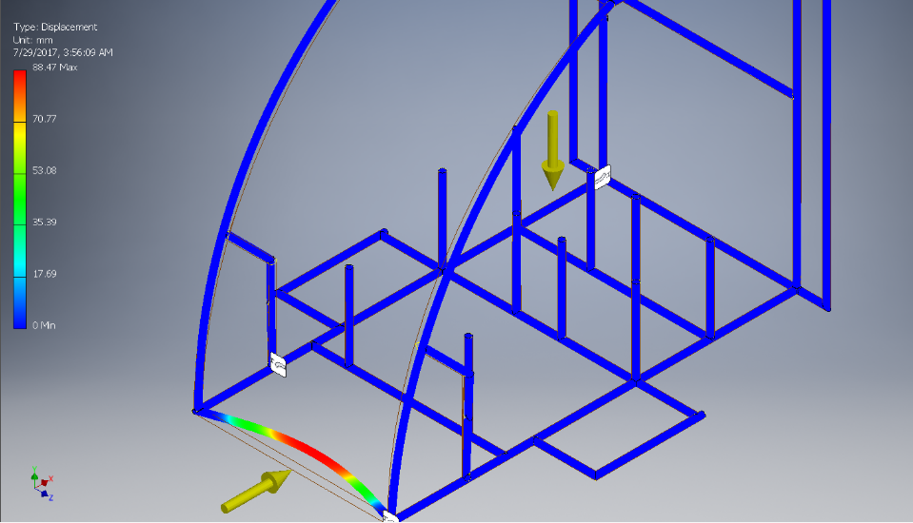
CAD / CAE report continued…
Material-2 (AISI 3074/25.4*21.4x2)
a) Assumption & Considerations:
Total mass of the vehicle including drivers, pay load being 400 kg
The vehicle was moving at 40 km/h while impact
While analysis , the force is applied on the front while the rear was kept rigid .
Impact timing being 0.13 seconds.
b) Calculation of Impact Forces:
Total mass of the vehicle, M =400N
Initial velocity before impact, V_{initial} = 9.72 m/s
Final velocity after impact, V_{final} will be zero.
Impact time = 0.13 seconds
Work done = change in kinetic energies.
From work energy principal,
Work done = change in kinetic energies W = (0.5 × M × V_{fina}l² - 0.5 × M × V _{initial}² )
│W│ = │- 0.5 × M × v_{initial}²│ =│- 0.5 × 400 × 9.72²│ = 18895.68 Nm
Now, Work done = force × displacement= F × s …… (1) s = impact time × v_{maximum} = 0.13 ×9.72 = 1.263 m So, from (1) we get, F = W/ s = 18895.68 / 1.263 = 14960.94N
c) Analysis Results:
Max displacement =18mm
Max Stress = 271 MPa
FOS=1.73

Slide 9
CAD / CAE report continued…
Particulars | AISI 1018 | AISI 3074 | AISI 1020
Front impact stress (MPa) | 260 | 271 | 297
Side impact stress (MPa) | 127 | 134 | 241.5
Roll impact stress (MPa) | 300 | 173 | 275
Average FOS | 1.80 | 2.22 | 1.293
Weight of frame | 38kg | 38kg | 38kg
Mnf. Cost/m | 105 | 78 | 92
FINAL MATERIAL SELECTION
Based on the above table of CAE analysis and the availability , we have chosen only one material for the frame , AISI 3074 , 2mm think and 1 inch outer diameter

Slide 10

Various events
Technical Inspection
Rulebook/Safety Compliance Check
‘Figure of 8’ Test
Electric Drive Inspection
Brake Test
Build Quality Check
Weight Measurement
Static Evaluations
Design Evaluation
Cost Evaluation
Build Quality Evaluation
CAE Award Evaluation
Innovation Award Evaluation
3) Dynamic Tests
Acceleration Test
Gradient Simulator Test
Drive Excellence Test
Endurance Run

Slide 11
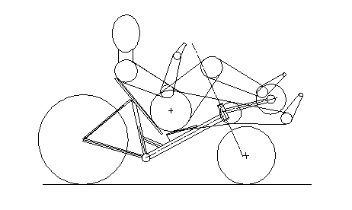
Key Features of our vehicle
Ergonomically designed
Regenerative breaking will be incorporated
Designed For easy maneuverability
Safe
Easy to ride

Slide 12
Cost Analysis
Particulars | Cost (Rs)
SAE Efficycle registration fees | 30000
Motor and battery | 22000
Roll Cage Material | 3000
Wheels and Tires | 2500
Braking System | 3180
Steering System | 3000
Gear Train | 2,000
Electrical Systems | 3000
Fabrication | 7,000
Safety Equipment | 5,000
Paint | 1500
Body panels and Fasteners | 1,000
Logistics | 15,000
Total | 99,000

Slide 13



SPONSORSHIP CATEGORY
DIAMOND
SPONSORS
More than ₹40,000
GOLD SPONSORS
More than ₹30,000
SILVER SPONSORS
₹20,000

Slide 14

DIAMOND SPONSORS more than ₹ 40,000
Advertising sponsored company on the vehicle
Advertising through display hoardings
Advertising on T-Shirt
Special mention in all the department events
Special mention in the team brochure

Slide 15
GOLD SPONSORS more than ₹ 30,000
Advertising sponsored company on the vehicle
Advertising through display hoardings
Advertising on T-Shirt
Special mention in all the department events

Slide 16

SILVER SPONSORS more than ₹ 20,000
Advertising sponsored company on the vehicle
Advertising through display hoardings
Advertising on T-Shirt

Slide 17
OTHER SPONSORS UPTO ₹ 20,000
Advertising sponsored company on the vehicle
Advertising through display hoardings
Mention in all the department events

Slide 18
Projected outreach :
Event foot fall : More than 100 teams x 12 members = 1200
(additionally staff , faculty , industry personals and student volunteers )
DSCE College events , Student count = 10,000
Team location (Kumarswami Layout , Bengaluru )
High density of young adult population (excluding students ) = 3000
Total Projected outreach = 14,300

